Slide 1
Principles and Patterns of eBay Architecture
Randy Shoup
May 14, 2010

Slide 2
Challenges at Internet Scale
eBay manages …
  Over 90 million active users worldwide
  Over 200 million items for sale in 50,000 categories
  Over 8 billion URL requests per day
… in a dynamic environment
  Hundreds of new features per quarter
  Roughly 10% of items are listed or ended every day
… worldwide
  In 39 countries and 10 languages
  24x7x365
>70 billion read / write operations / day

Slide 3
Architectural Forces: What do we think about?
Scalability
  Resource usage should increase linearly (or better!) with load
  Design for 10x growth in data, traffic, users, etc.
Availability
  Resilience to failure
  Graceful degradation
  Recoverability from failure
Latency
  User experience latency
  Data latency
Manageability
  Simplicity
  Maintainability
  Diagnostics
Cost
  Development effort and complexity
  Operational cost (TCO)

Slide 4
Principles for Internet Scale
1. Partition Everything
2. Asynchrony Everywhere
3. Automate Everything
4. Remember Everything Fails
5. Embrace Inconsistency

Slide 5
Principle 1: Partition Everything
Split every problem into manageable chunks
  Split by data, load, and/or usage pattern
  “If you can’t split it, you can’t scale it”
Motivations
  Scalability: scale horizontally and independently
  Availability: isolate failures
  Manageability: decouple different segments and functional areas
  Cost: choose partition size that maximizes price-performance
Partitioning Patterns
  Functional Segmentation
  Horizontal Split

Slide 6
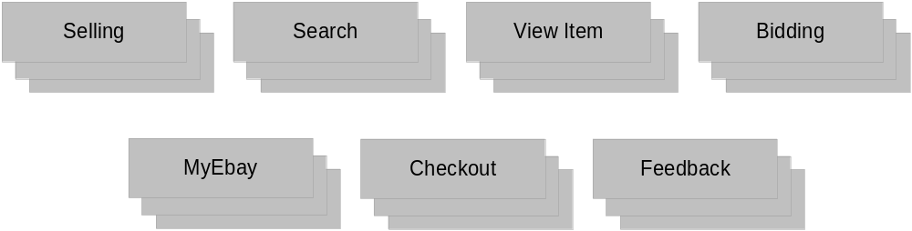

Partition Everything: Functional Segmentation
Segment processing into pools, services, and stages
Segment data by entity and usage pattern
  Logical host abstracts application’s logical representation from database’s physical location
  Supports collocating and separating hosts without code change
Over 1000 logical databases on ~400 physical hosts

Slide 7
Partition Everything: Horizontal Split
Load-balance processing
  All servers in a pool are created equal
Split (or “shard”) data along primary access path
  Many split strategies: modulo of a key, range, lookup table, etc.
  Aggregation / routing in Data Access Layer (DAL)
  Abstract developers from split logic, logical-physical mapping

Slide 8
Corollary: No Session State
User session flows through multiple pools
Absolutely no session state or business object caching in application tier
  No HttpSession, no EJBs
Transient session state maintained in (or referenced by) cookie, URL
Extended session state in GemCache or database

Slide 9
Principle 2: Async Everywhere
Prefer Asynchronous Processing
  Move most processing to asynchronous flows
  Integrate components asynchronously
Motivations
  Scalability: scale components independently
  Availability: Decouple availability state, retry operations
  Latency: trade execution latency for response latency
  Cost: spread peak load over time
Asynchrony Patterns
  Event Queue
  Message Multicast
  Batch

Slide 10
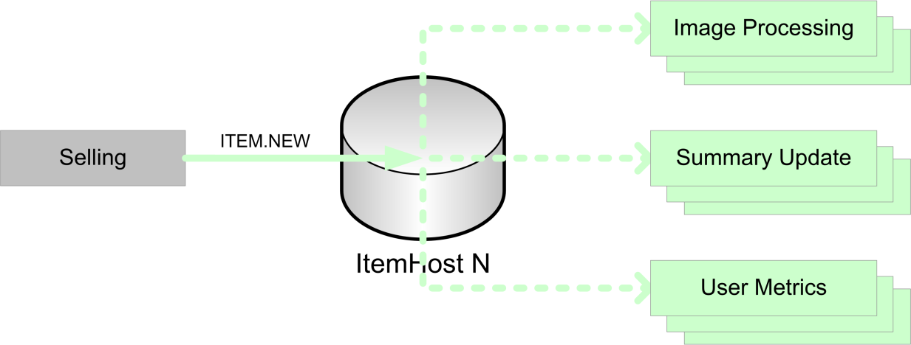
Async Everywhere: Business Event Streams (BES)
Pattern: Event Queue
  Primary use case writes data and queues event
    E.g., ITEM.NEW, BID.NEW, ITEM.SOLD, etc.
    Event created transactionally with insert/update of primary table
  Consumers subscribe to event
    At least once delivery, rather than exactly once
    No guaranteed order, rather than in-order
  Managing timing conditions
    Idempotency: processing event N times should give same results as processing once
    Readback: consumer typically reads back to primary database for latest data
  Multiple logical consumers can process each event, each with its own event queue
  Over 100 logical consumers consuming ~300 event types

Slide 11
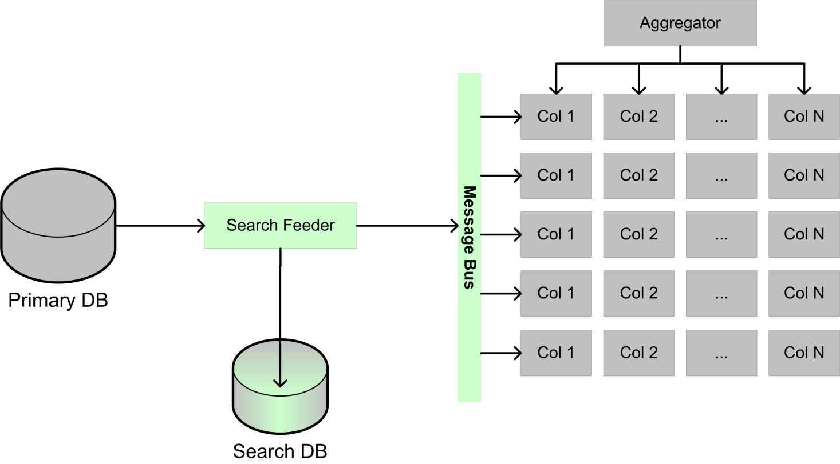
Async Everywhere: Search Feeder (“ItemStore”)
Pattern: Message Multicast
  Feeder reads item updates from primary database
  Feeder publishes updates via reliable multicast
    Persist messages in intermediate data store for recovery
    Publish sequenced updates via multicast to search grid using SRM-inspired protocol
    Resend recovery messages when messages are missed
  Search nodes listen to updates
    Listen to assigned subset of messages
    Update in-memory index in real time
    Request recovery (NAK) when messages
    are missed

Slide 12
Async Everywhere: Batch
Pattern: Periodic Batch
  Scheduled offline batch process
  Most appropriate for
    Infrequent, periodic, or scheduled processing (once per day, week, month)
    Non-incremental computation (a.k.a. “Full Table Scan”)
  Examples
    Import third-party data (catalogs, currency, etc.)
    Generate recommendations (items, products, searches, etc.)
    Process items at end of auction
  Often drives further downstream processing through Event Queue

Slide 13
Principle 3: Automate Everything
Prefer Adaptive / Automated Systems to Manual Systems
  Design systems which adapt to their environment
  Engineer feedback loops to learn over time
Motivations
  Scalability: scale with machines, not humans
  Availability / Latency: adapt to changing environment more rapidly
  Cost: machines are less expensive than humans
Automation Patterns
  Adaptive Configuration
  Machine Learning

Slide 14
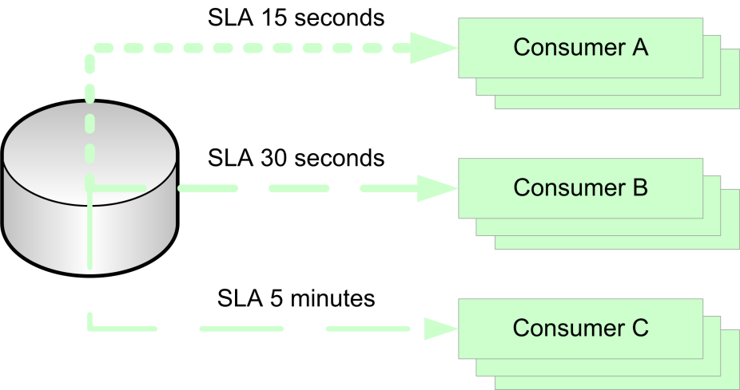
Automate Everything: BES Consumer Configuration
Pattern: Adaptive Configuration
  Do not manually configure event consumers
    Polling size and frequency
    Number of threads
  Define service-level agreement (SLA) for a given logical event consumer
    E.g., 99% of events processed in 15 seconds
    Each consumer dynamically adjusts to meet defined SLA with minimal resources
  Consumers automatically adapt to changes in
    Load (queue length)
    Event processing time
    Number of consumer instances

Slide 15
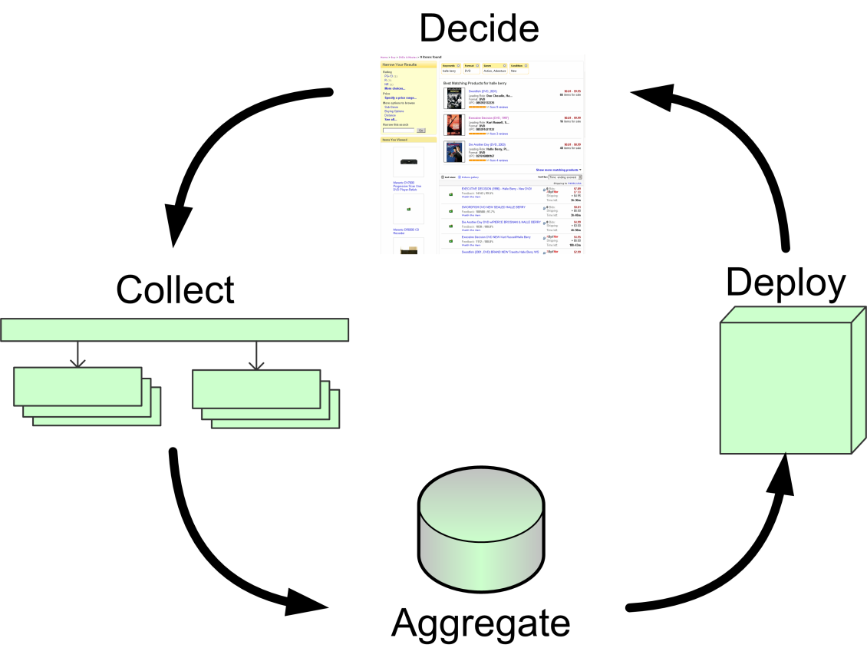
Automate Everything: Adaptive Finding Experience
Pattern: Machine Learning
  Dynamically adapt search experience
    Best Match: Order results by combination of demand, supply, and other factors
    Traffic Optimizer: Choose page, modules, and inventory which provide best experience for that user and context
  Feedback loop enables system to learn and improve over time
    Collect user behavior
    Aggregate and analyze offline
    Deploy updated metadata
    Decide on and serve appropriate experience

Slide 16
Principle 4: Remember Everything Fails
Build all systems to be tolerant of failure
  Assume every operation will fail and every resource will be unavailable
  Detect failure as rapidly as possible
  Recover from failure as rapidly as possible
  Do as much as possible during failure
Motivation
  Availability
Failure Patterns
  Failure Detection
  Rollback
  Graceful Degradation

Slide 17
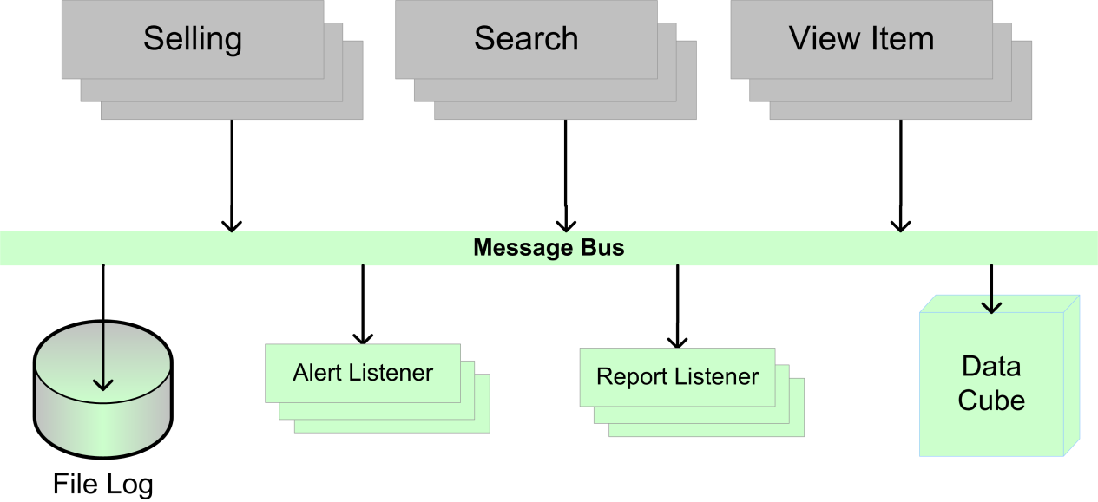
Everything Fails: Central Application Logging (CAL)
Pattern: Failure Detection
  Application servers log all requests on multicast bus
    Log all application activity, database and service calls on the bus
    Log request, application-generated information, and exceptions
  Listeners automate failure detection and notification
    Real-time application state monitoring: exceptions and operational alerts
    Historical reports by application server pool, URL, database, etc.
  Over 25TB (3TB compressed) of log messages per day

Slide 18
Everything Fails: Code Rollout / Rollback
Pattern: Rollback
  Absolutely no changes to the site which cannot be undone (!)
  Entire site rolled every week: 16,000 application servers in 220 pools
  Most deployed features have dependencies between pools
  Rollout Plan contains explicit set (transitive closure) of all rollout dependencies
  TurboRoller executes staged rollout, with built-in checkpoints and immediate rollback if necessary
  TurboRoller optimizes rollback, including full rollback of dependent pools

Slide 19
Everything Fails: Feature Wire-on / Wire-off
Pattern: Rollback
  Every feature has on / off state (“Partner Contingency”) driven by central configuration
  Can immediately turn feature off for operational or business reasons
  Can deploy “wired-off” to unroll dependencies
    Decouples code deployment from feature deployment
  For an application, feature “availability” is just like resource availability

Slide 20
Everything Fails: Resource Markdown
Pattern: Failure Detection
  Application detects when database or other backend resource is unavailable or distressed
    “Resource slow” is often far more challenging than “resource down” (!)
  Application “marks down” the resource
    Stops making calls to it and sends alert
Pattern: Graceful Degradation
  Remove or ignore non-critical functionality
  Retry or defer critical functionality
    Failover to alternate resource
    Defer processing to BES event
  Explicit “markup”
    Allows resource to be restored and brought online in a controlled way

Slide 21
Principle 5: Embrace Inconsistency
Brewer’s CAP Theorem
  Any shared-data system can have at most two of the following properties:
    Consistency: All clients see the same data, even in the presence of updates
    Availability: All clients will get a response, even in the presence of failures
    Partition-tolerance: The system properties hold even when the network is partitioned
This trade-off is fundamental to all distributed systems

Slide 22
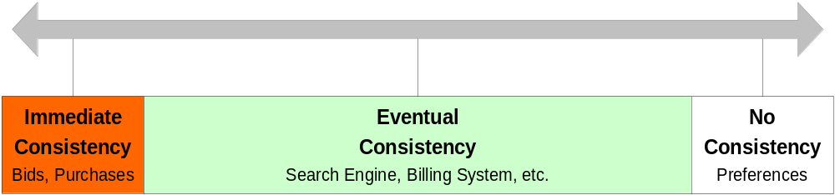
Principle 5: Embrace Inconsistency
Choose Appropriate Consistency Guarantees
Typically eBay trades off immediate consistency for availability and partition-tolerance
  Choose A and P; give up C
Most real-world systems do not require immediate consistency (even financial systems!)
  “Settlement”: financial parties reconcile and resolve conflicts at end of trading day
Consistency is a spectrum

Slide 23
Principle 5: Embrace Inconsistency
Avoid Distributed Transactions
eBay does absolutely no distributed transactions
  No JDBC client transactions, no 2PC, etc.
Minimize inconsistency through state machines and careful ordering of database operations
Reach eventual consistency through asynchronous event or reconciliation batch

Slide 24
Recap: Principles for Internet Scale
1. Partition Everything
2. Asynchrony Everywhere
3. Automate Everything
4. Remember Everything Fails
5. Embrace Inconsistency

Slide 25
Questions?
Randy Shoup
  rshoup@ebay.com

